Slide 1
VEHICLE LOAN DEFAULT
PREDICTION
By:
GROUP 1

Slide 2
PROBLEM STATEMENT
Identify the possibility of defaulting on the loan payments, thereby making it easier for financial institutes to verify an individual and minimise the risk of bad debts.
This is important as stringent criteria were developed which has now led to more number of rejections therefore hampering the lending business.
The additional value that this algorithm will provide is:
  Quick processing of loan for approval by the bank.
  Help with reducing the rejection rates of capable candidates therefore increasing the profitability and goodwill of the financial institute.

Slide 3
PROBLEM SOLVING METHODOLOGY
DATA UNDERSTANDING
  233154 rows and 41 columns.
  There are 12 categorical variables and 29 numerical variables.
  Data Redundancy is less.
  Some Categorical Features - Employment Type, Flag Columns, CNS Score Description
  Some Numerical Features - Disbursal Amount, Asset Cost, LTV, Primary and Secondary Columns
  Univariate and Bivariate analysis.

Slide 4
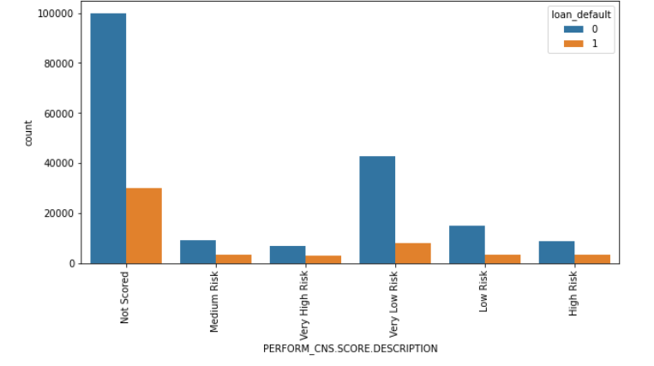
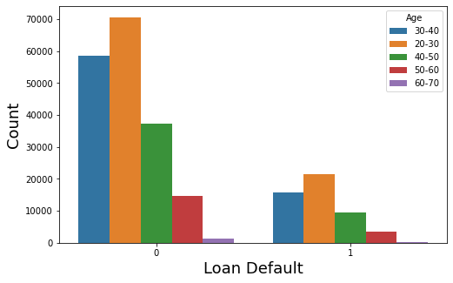
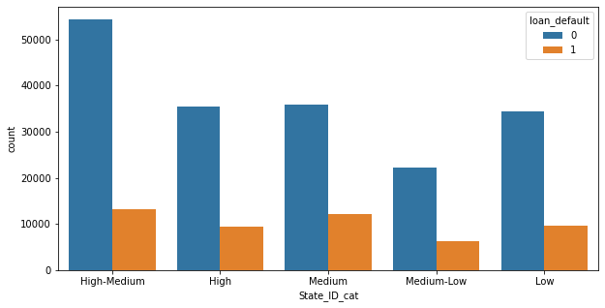
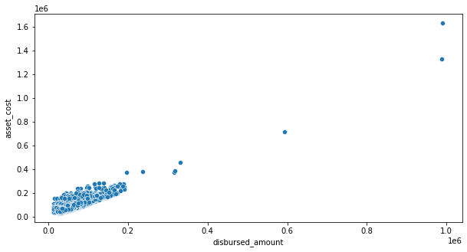
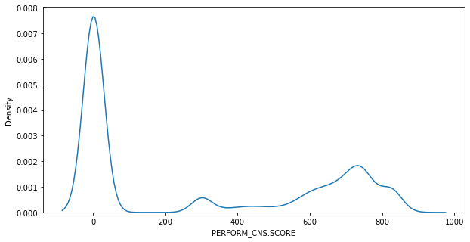
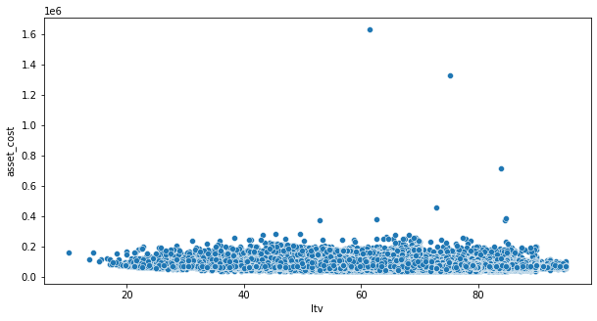
CATEGORICAL COLUMNS:
NUMERICAL COLUMNS:

Slide 5
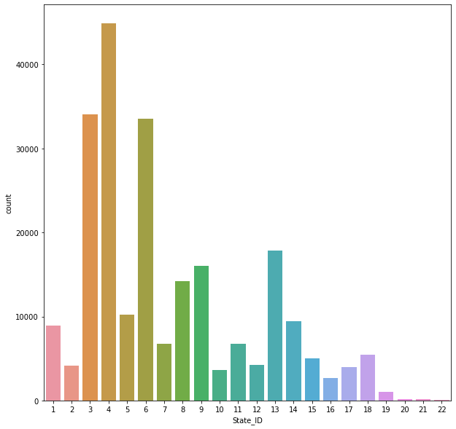
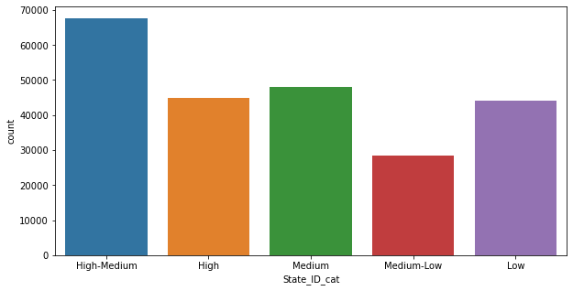
DATA PREPARATION AND EDA
  Null Value treatment. - Employment Type - 7661.
  Outlier treatment.
  Feature Engineering.
  Scaling.
Feature Engineering for State ID Feature

Slide 6
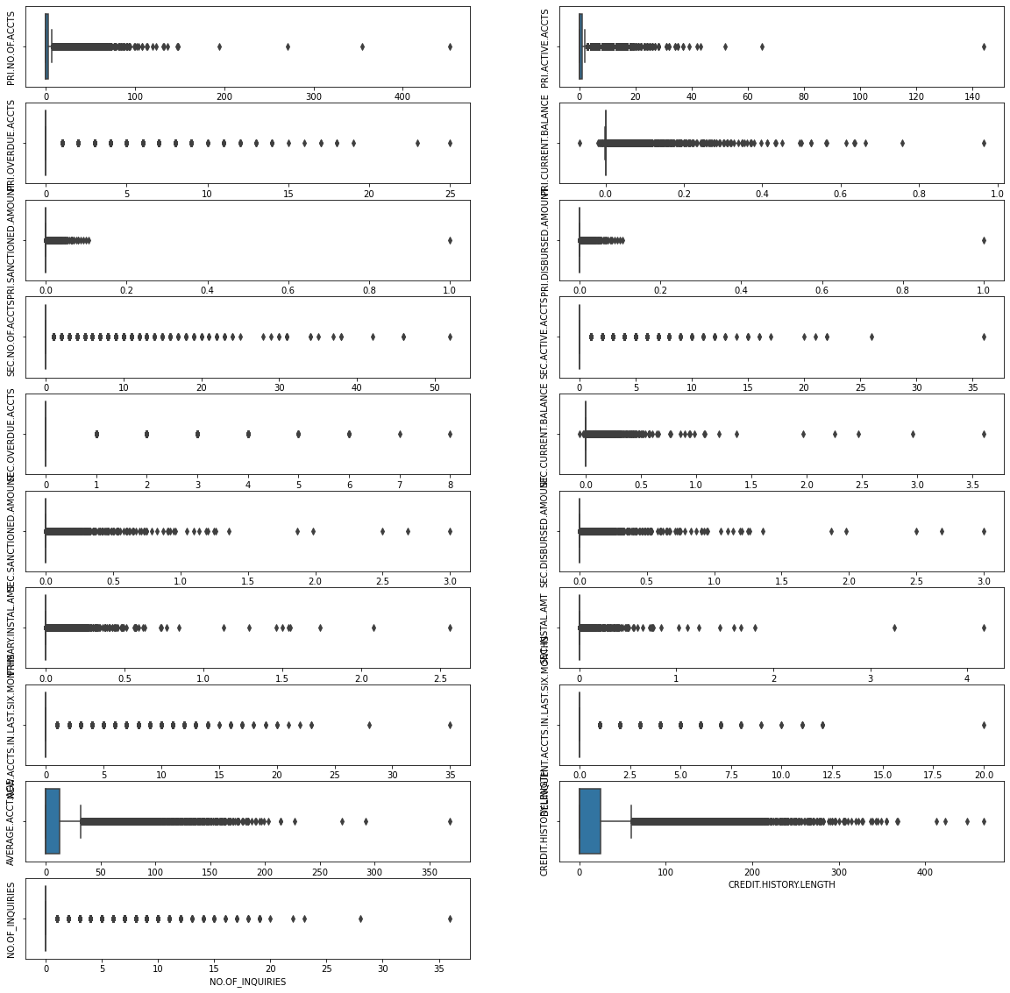
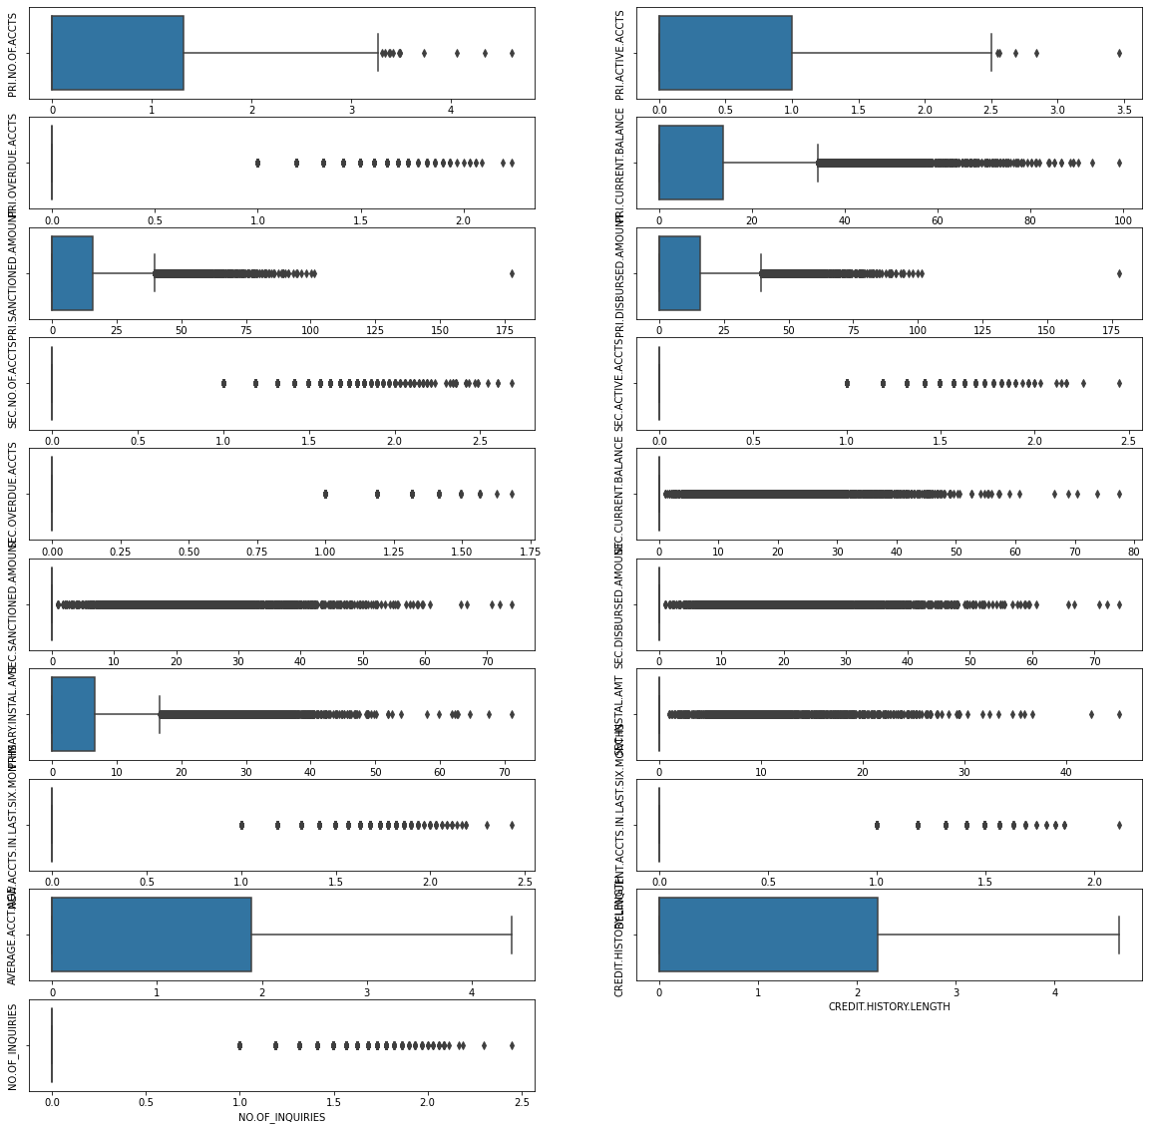
BEFORE SQRT TRANSFORM
AFTER SQRT TRANSFORM

Slide 7
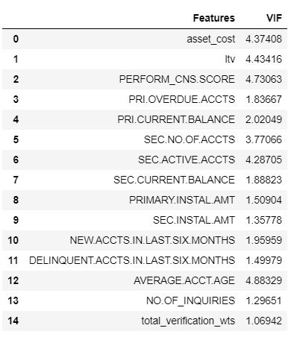
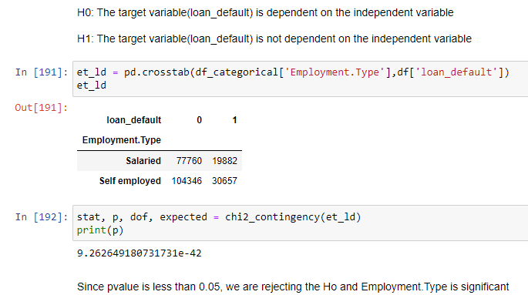
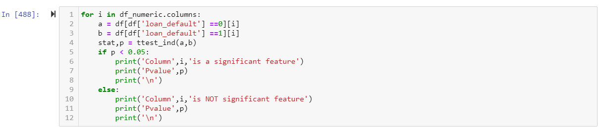
FEATURE SELECTION
Chi-Square
Ttest

Slide 8
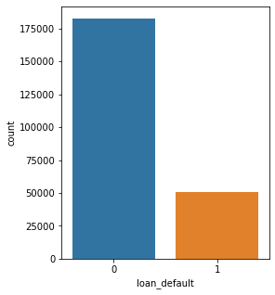
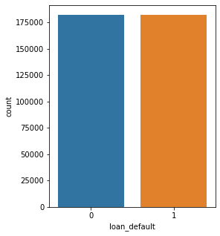
SAMPLING

Slide 9
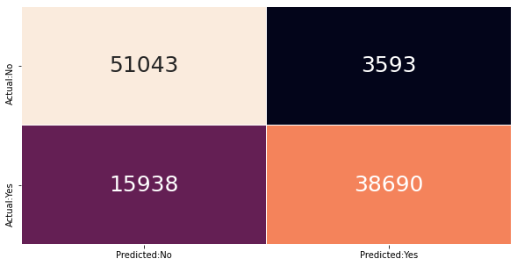

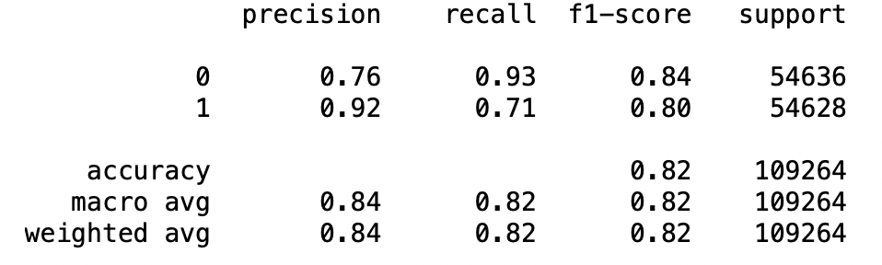
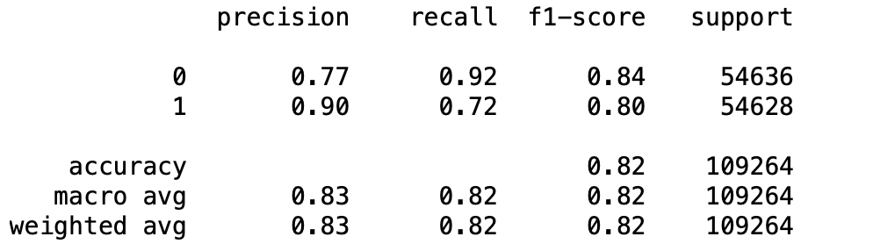
BEFORE TUNING: XGBOOST
AFTER TUNING: XGBOOST

Slide 10
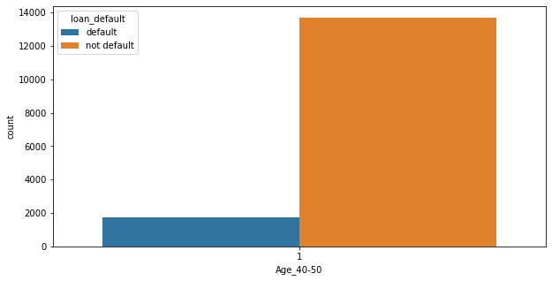
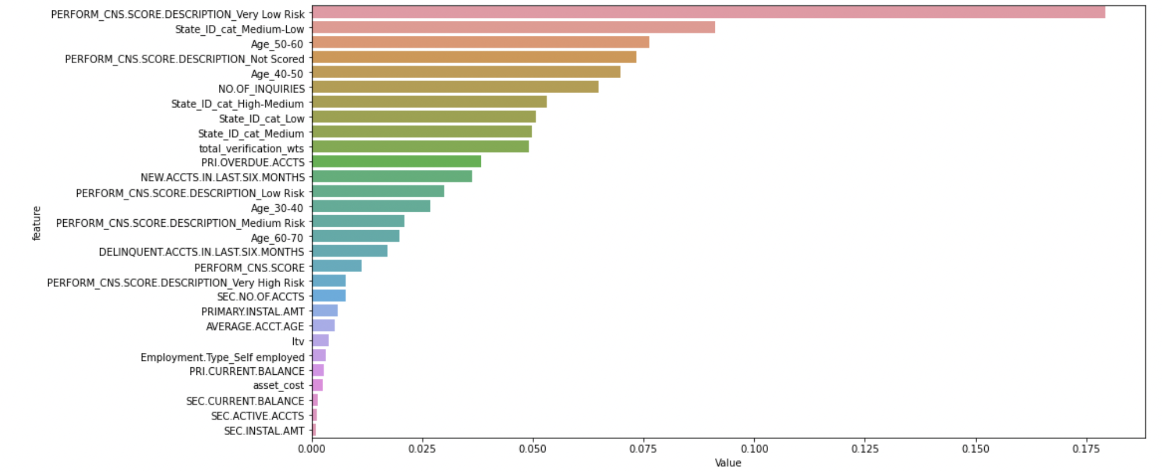
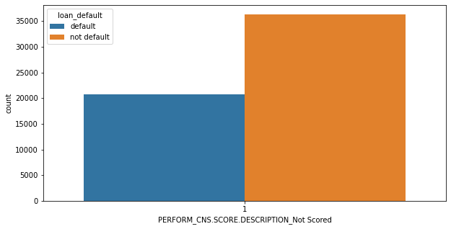
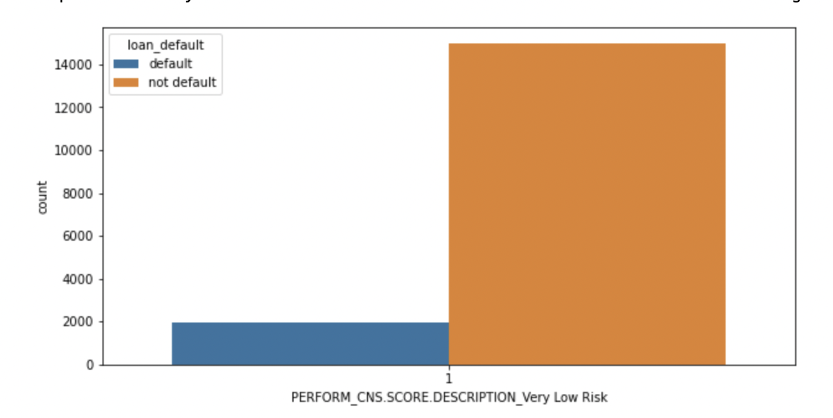
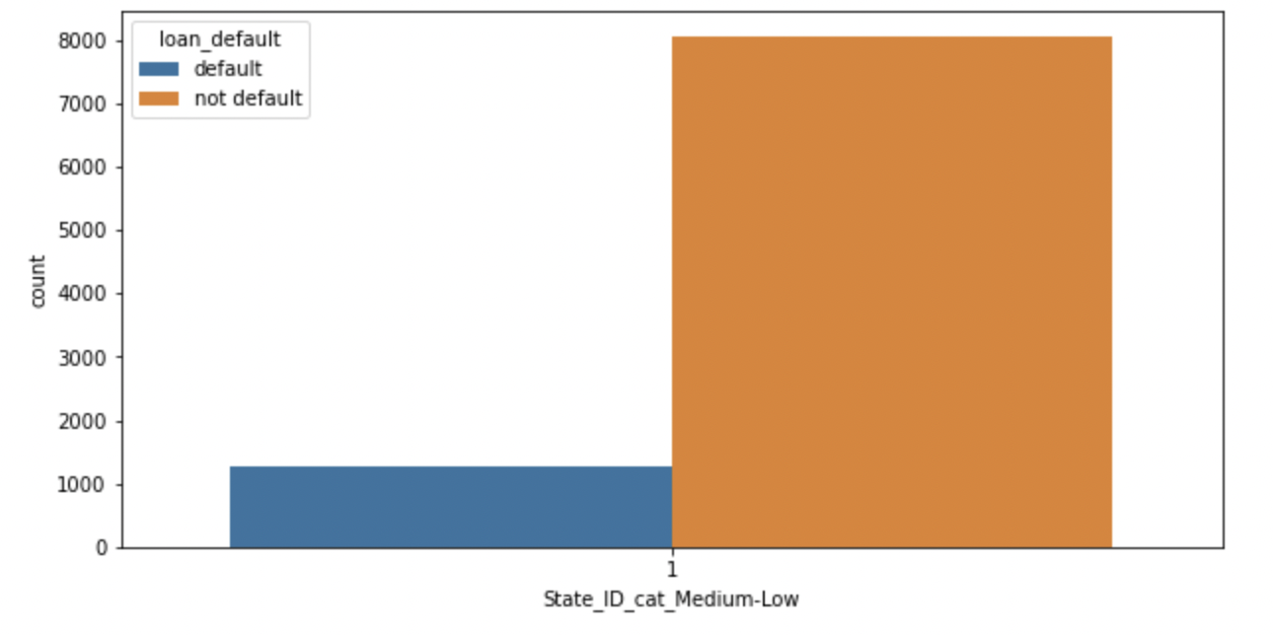
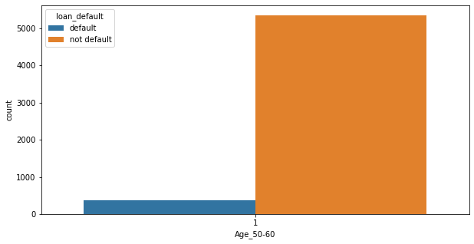
SALIENT FEATURES

Slide 11
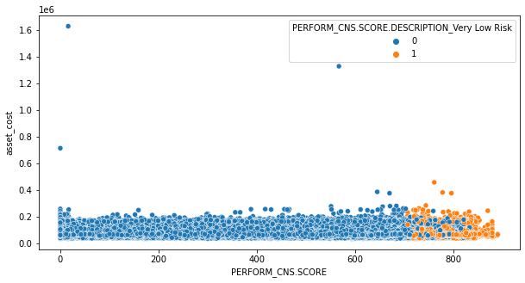
RECOMMENDATIONS AND STRATEGIES
Makes business happy
Does not make business happy
Regardless of what the asset cost is, as long as loanees have a CNS Score ranging between 700-900, their chances of loan defaulting will be less
CNS Score: Very Low Risk i.e, having a good CNS score of 706-890 and loanees who do not have a CNS Score.
Loanees belonging to 40-60 Age Category.
People belonging to States with State IDs 1, 5 and 14.

Slide 12
LIMITATIONS AND ENHANCEMENTS FOR MODEL
Limitations-
  0.28 chance of predicting False Negatives, i.e., loan defaulters who are predicted as non-defaulters.
  Sensitive data.
  Outlier presence.
  Real world problem.
Enhancement Solutions -
  Currently 52% of the loanees fall into the CNS Not Scored Category.
  As CNS Not scored is an important feature, providing updates on the loanees or gathering more information on them, might lead to better prediction.
LEARNINGS AND REFLECTIONS
Effective Model Building.
Domain Knowledge.
Attention to detail

Slide 13
MENTOR
Ankush Bansal
MEMBERS
Meghana S
Nikhitha Siddi
Sai Venkata Shreya Gudipati
Shubham Dey
Titash Sengupta
:
THANK YOU

